Slide 1
Insurance & Retirement Services
CUSIP Profile User Guide
DTCC Confidential - Green

Slide 2
This guide will show you how to use the CUSIP Profile web services application. The following tasks will be covered:
Log in
Add CUSIP
Browse for CUSIP
Update CUSIP
Delete CUSIP
Upload CUSIP
CUSIP History

Slide 3
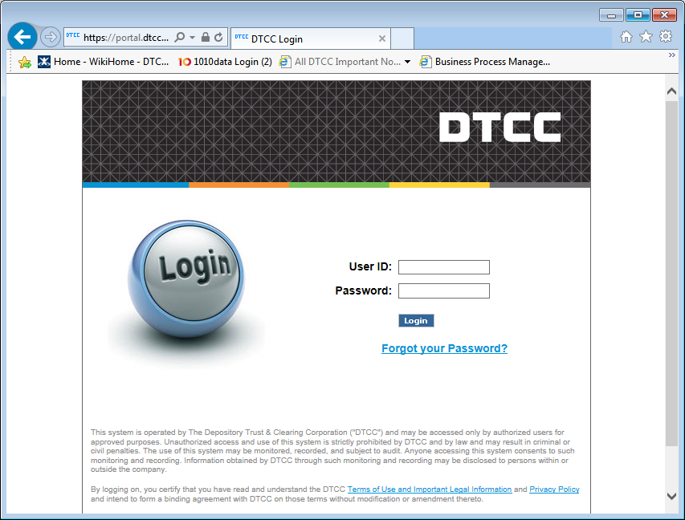
Logging In To The DTCC Portal
Type in your User ID and Password and click Login to enter DTCC portal

Slide 4
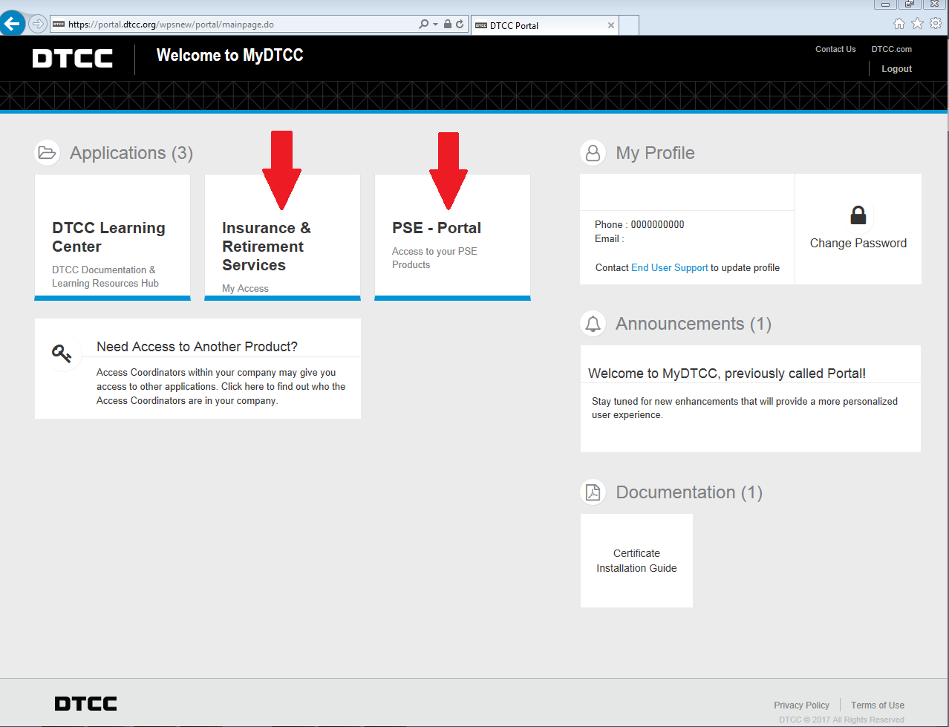
Accessing the I&RS Dashboard
Click the Insurance & Retirement Services tile or the Insurance & Retirement Services PSE – Portal tile for Test.

Slide 5
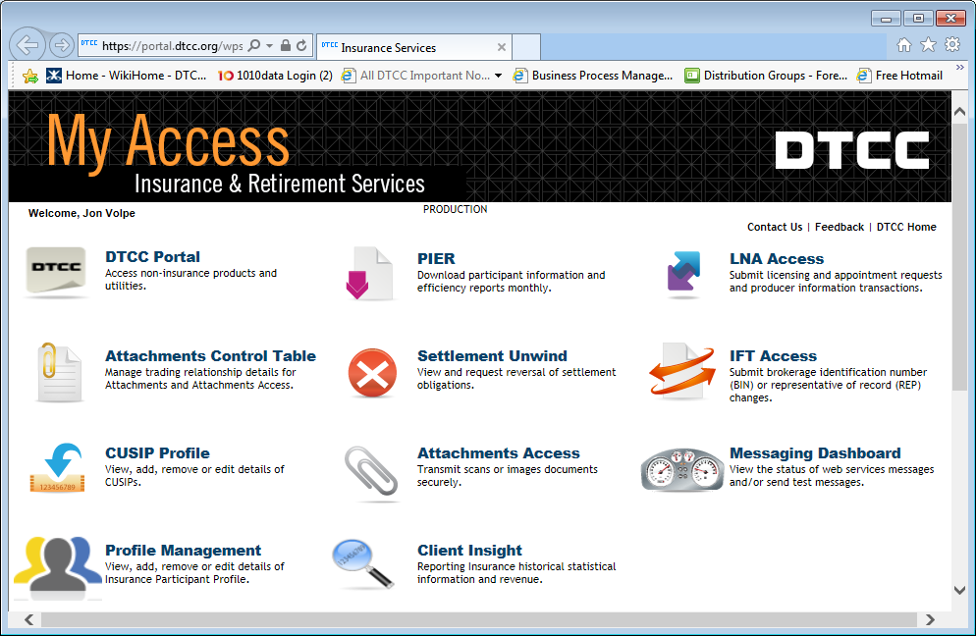
Accessing CUSIP Profile
Click the CUSIP Profile Icon

Slide 6
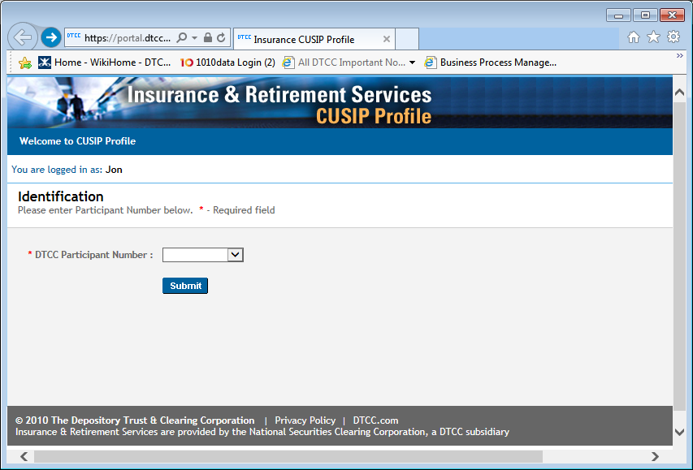
Participant Identification
Select DTCC participant number from the dropdown and click submit

Slide 7
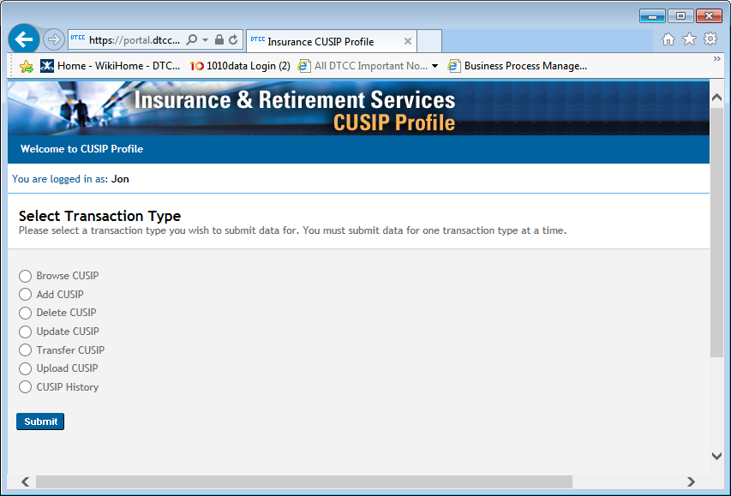
Select Transaction Type
Select a transaction type and click submit

Slide 8
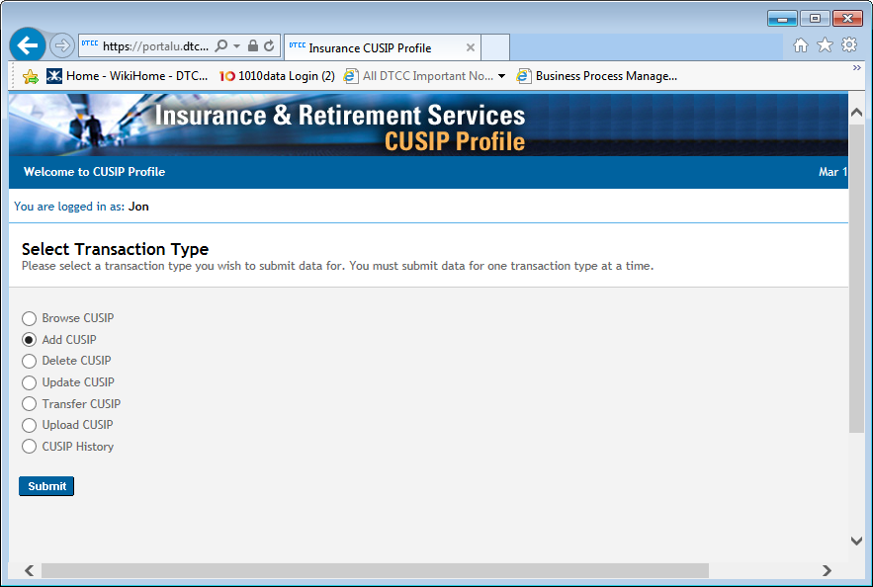
Add CUSIP
Select Add CUSIP and click Submit

Slide 9
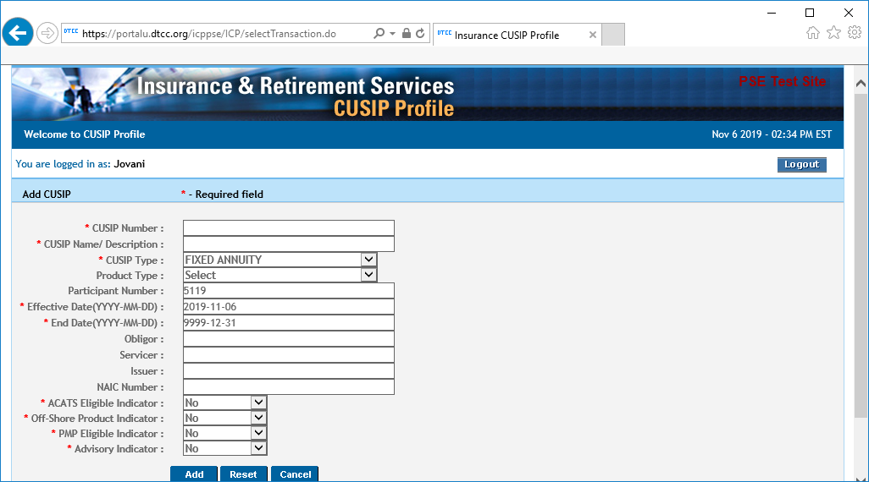
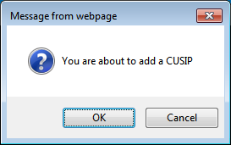
Add CUSIP
Fill out the desired fields. Required fields are indicated by a red asterisk (*).
Click Add to add the CUISP.
A confirmation window will appear
Click Ok to confirm
Note: Reset clears all the fields and Cancel brings you back to the Select Transaction Type screen.

Slide 10
Add CUSIP
A confirmation message appears.
Click Continue to return to the Select Transaction Type screen.

Slide 11

Browse CUSIP
Select Browse CUSIP and click Submit.

Slide 12
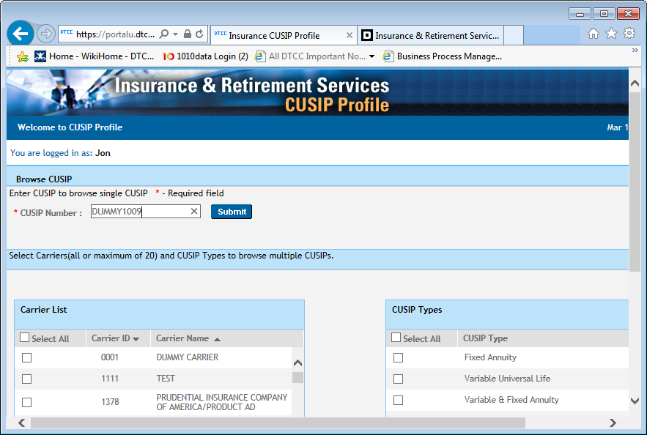
Browse CUSIP - Single
To browse a single CUSIP, type the CUSIP and click Submit.

Slide 13
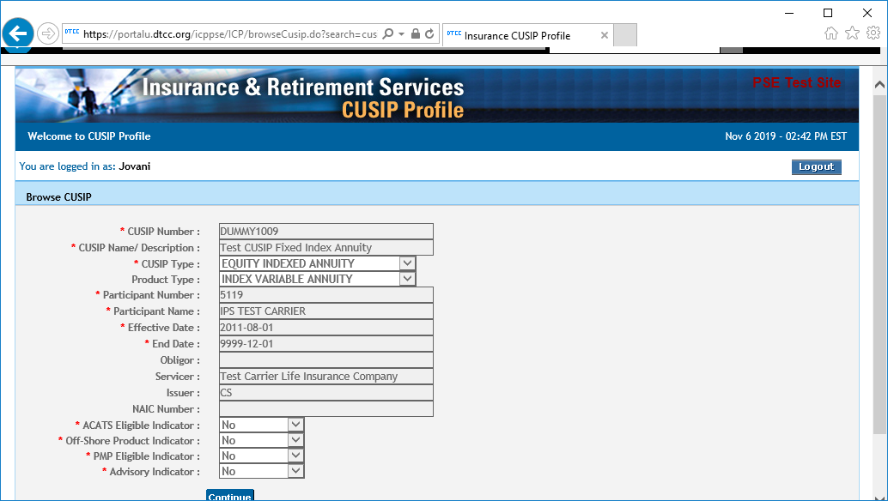
Browse CUSIP - Single
The CUSIP is displayed.
Click Continue to return to the Select Transaction Type screen.

Slide 14
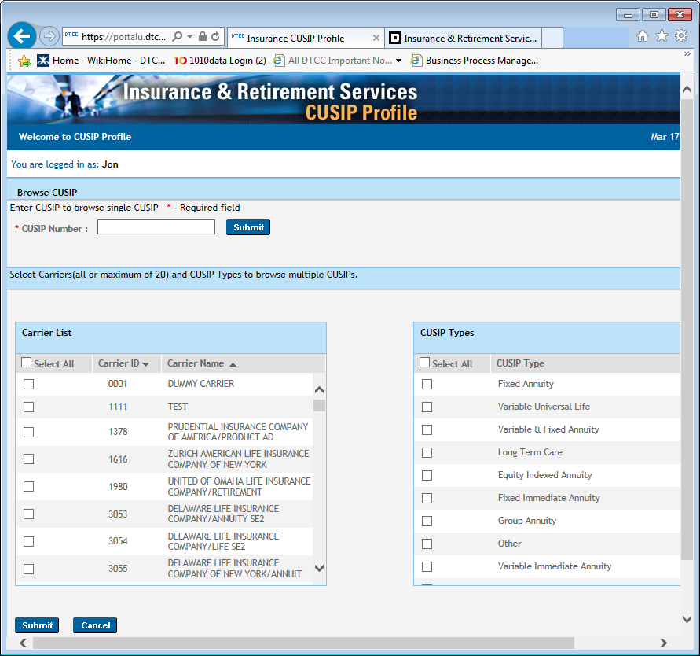
Browse CUSIP - Multiple
To browse multiple CUSIPs:
Select the Carriers and CUSIP Types you want to browse.
Click Submit.
Note: Cancel brings you back to the Select Transaction Type screen.

Slide 15
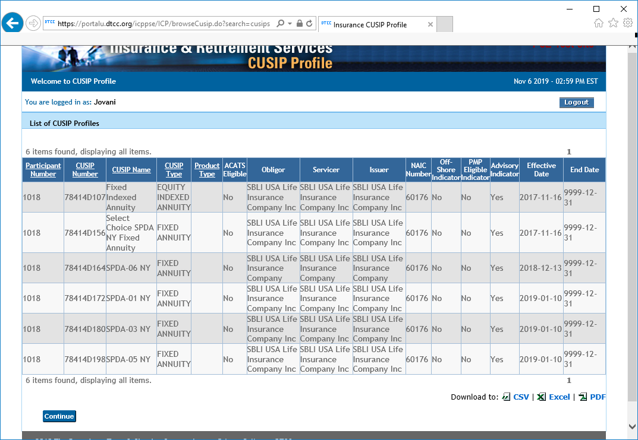
Browse CUSIP - Multiple
The matched CUSIPs are displayed.
Browse through the multiple pages to view the different CUSIPs.
You can sort the different columns by clicking on the column headings. You can also download the results to Excel, CSV and/or PDF
Note: Continue brings you back to the Select Transaction Type screen.

Slide 16
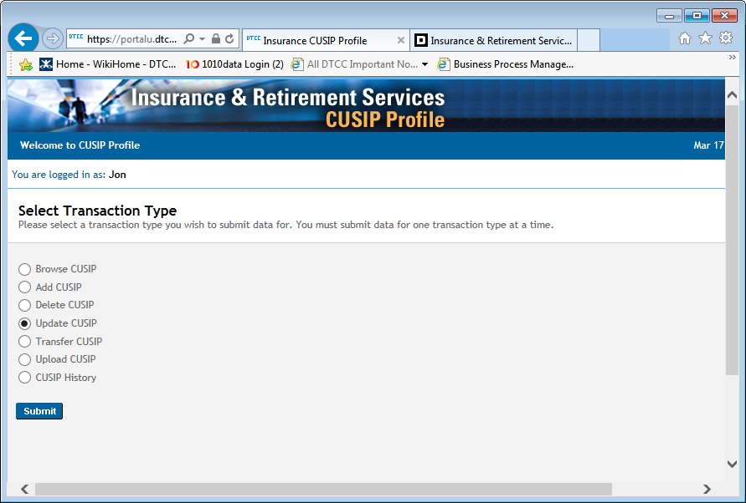
Update CUSIP
Select Update CUSIP and click Submit.

Slide 17
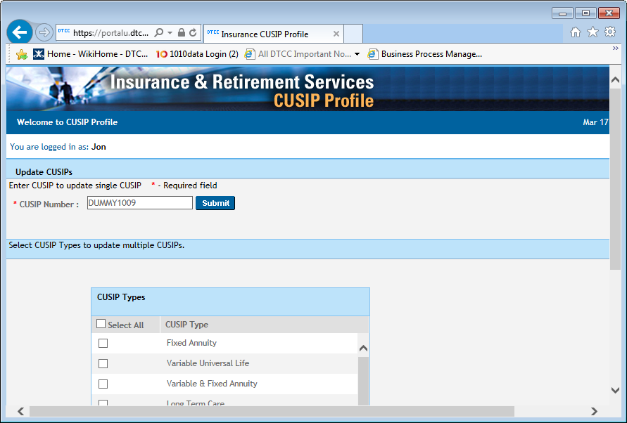
Update CUSIP - Single
To update a single CUSIP, type the CUSIP and click Submit.

Slide 18
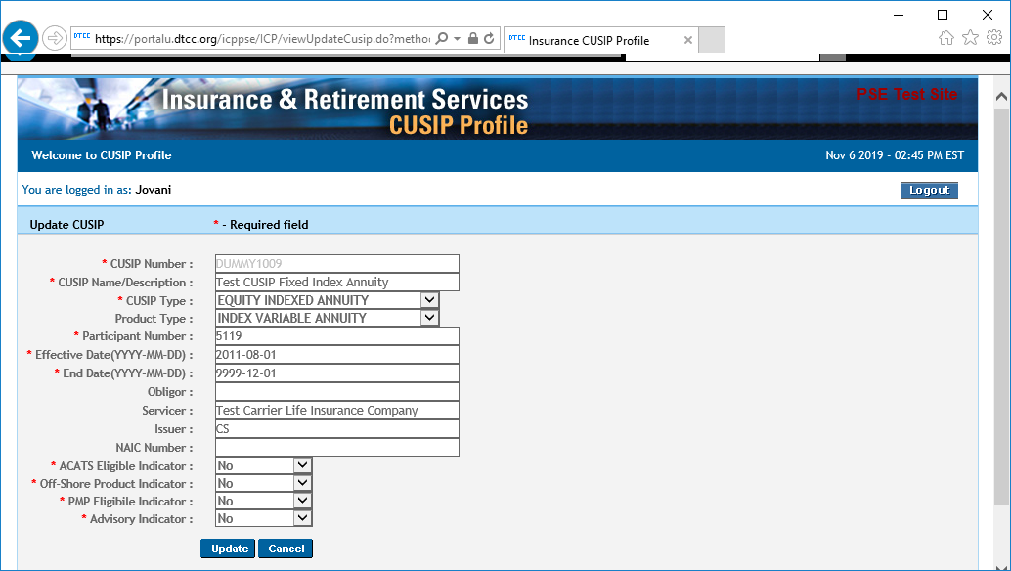
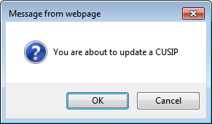

Update CUSIP - Single
Change the fields you wish to update. Required fields are indicated by a red asterisk (*).
Click Update and a confirmation window will appear. Click OK to confirm updates.
Note: Cancel brings you back to the Select Transaction Type screen.

Slide 19
Update CUSIP - Single
A confirmation message appears.
Click Continue to return to the Select Transaction Type screen.

Slide 20
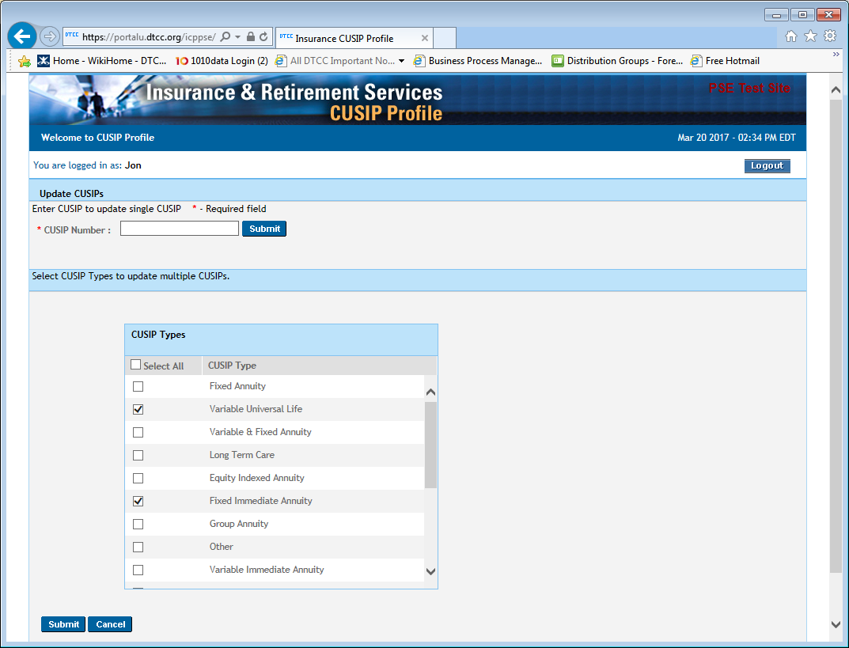

Update CUSIP - Multiple
To update multiple CUSIPs select the CUSIP types you want to search.
Click Submit to find the results that match the selections.
Note: Cancel brings you back the Select Transaction Type screen.

Slide 21
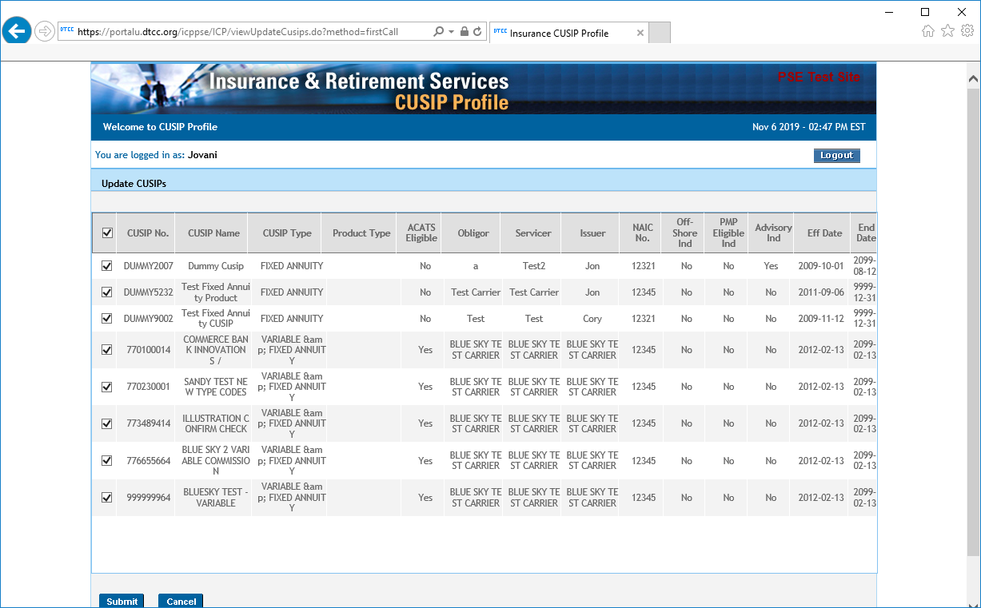

Update CUSIP - Multiple
A page with the CUSIP results appears.
Select each CUSIP you wish to update and click Submit.
Note: Cancel brings you back the Select Transaction Type screen.

Slide 22
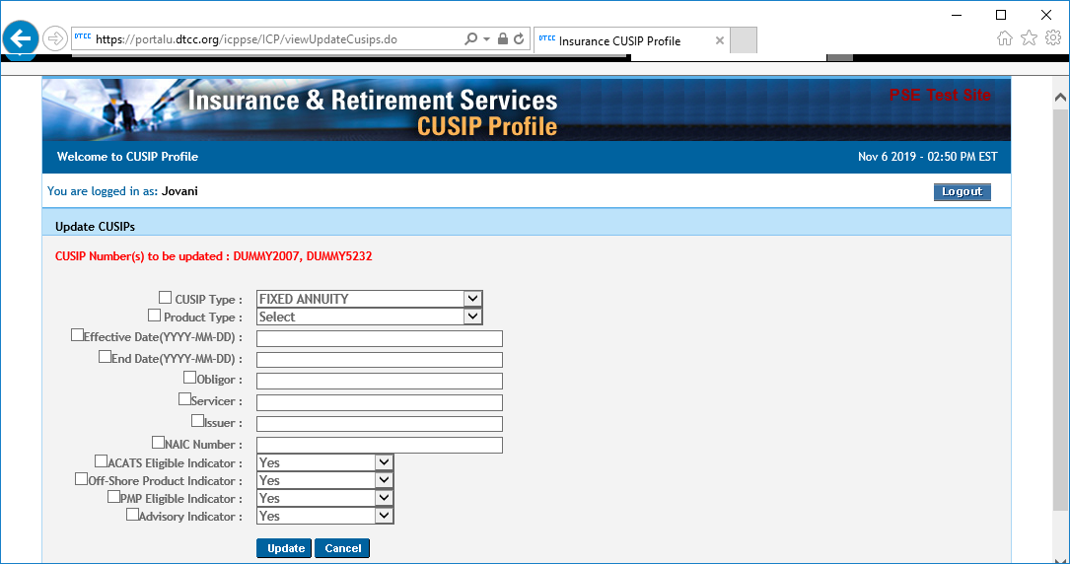

Update CUSIP – Multiple
Click the checkbox and type in the fields you want to update and click Update.
Updated fields will update in all selected CUSIPs.
Note: Cancel brings you back the Select Transaction Type screen.

Slide 23
Update CUSIP – Multiple
A confirmation message appears.
Click Continue to return to the Select Transaction Type screen.

Slide 24
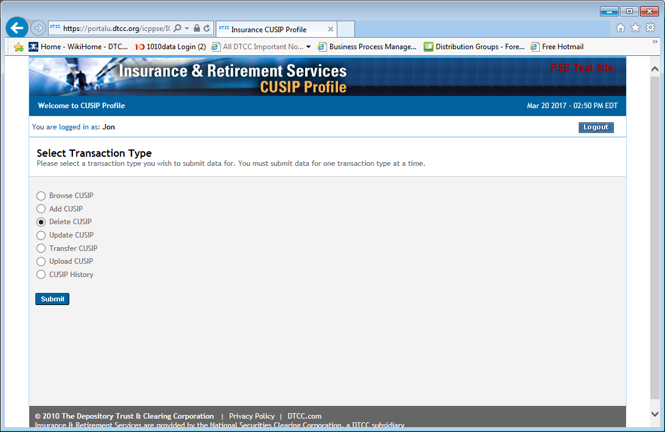
Delete CUSIP
Select Delete CUSIP and click Submit.

Slide 25
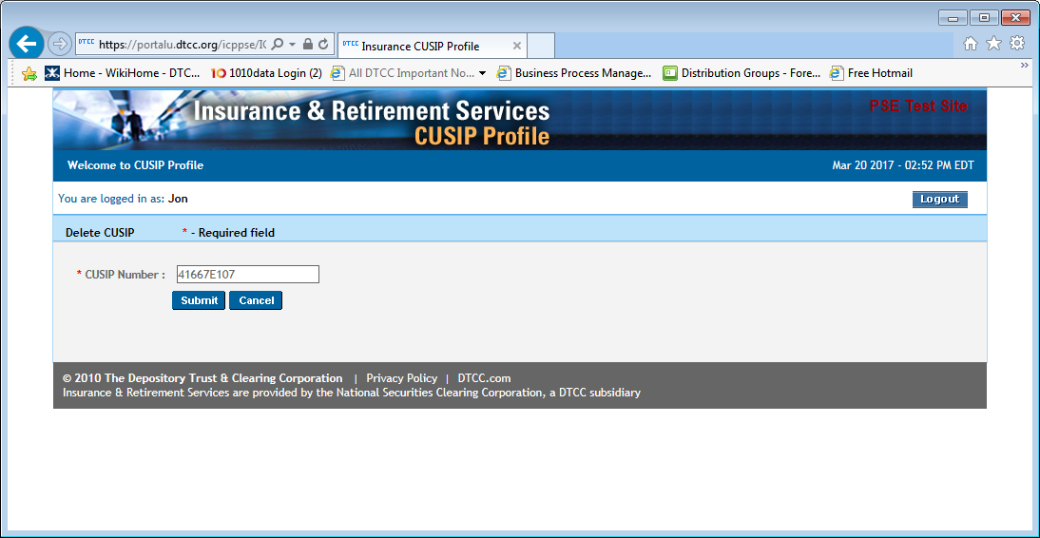

Delete CUSIP
Type the CUSIP you wish to delete and click Submit.
Note: Cancel brings you back the Select Transaction Type screen.

Slide 26
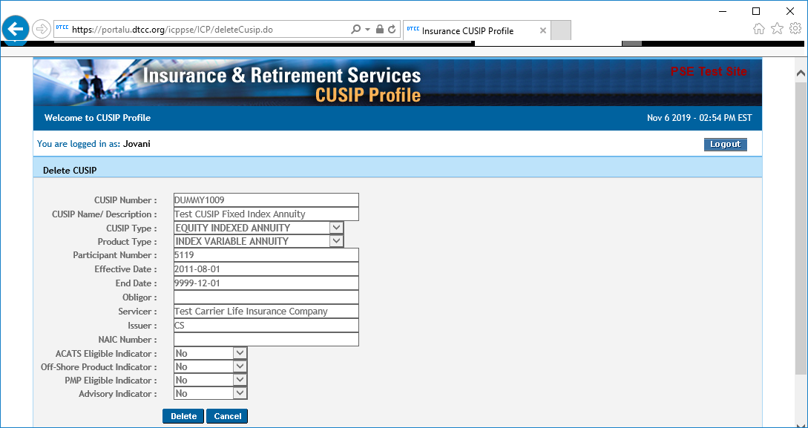

Delete CUSIP
Click Delete to delete the CUSIP.
A confirmation window will appear.
Click OK to confirm you would like to delete the CUSIP.
Note: Cancel brings you back the Select Transaction Type screen.

Slide 27
Delete CUSIP
A confirmation message appears.
Click Continue to return to the Select Transaction Type screen.

Slide 28
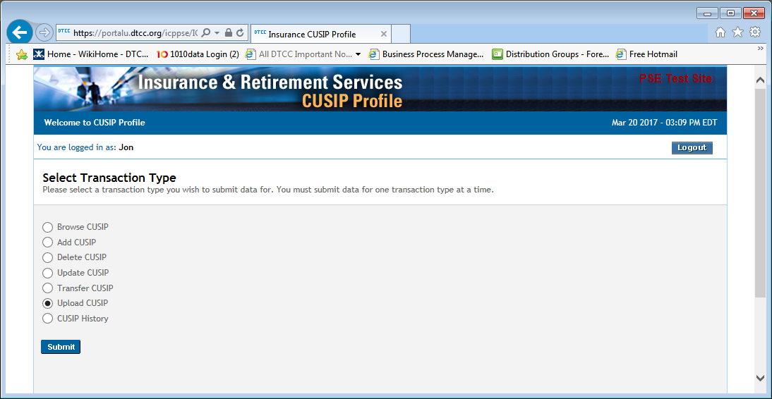
Upload CUSIP
Select Upload CUSIP and click Submit.

Slide 29



Upload CUSIP
Click Browse and select the CSV file to upload.
Click Open to select the CSV file to upload.
Note: To create a CUSIP Profile Upload CSV file, open the file called “CUSIP Profile Upload Template.xls” on the I&RS website under Client Services, then CUSIP Profile section on the CUSIP Information page and follow the procedure.

Slide 30
Upload CUSIP
Click the Upload button and a confirmation window will appear.
Click OK to confirm that you want to upload the file.
Note: Cancel brings you back the Select Transaction Type screen.

Slide 31
Upload CUSIP
A confirmation message appears.
Click Continue to return to the Select Transaction Type screen.

Slide 32
Upload CUSIP
If CUSIPs are rejected, the following screen appears.

Slide 33
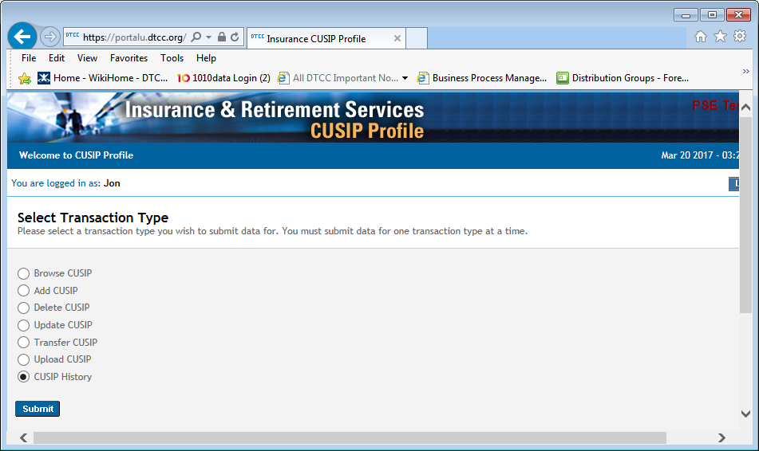
CUSIP History
Select CUSIP History and click Submit.

Slide 34

CUSIP History
Type the CUSIP or click the arrow to open the CUSIP List window.
Click the Description name of the CUSIP you want to select.
Click Submit to search the history of that CUSIP.
Note: Cancel brings you back the Select Transaction Type screen.

Slide 35
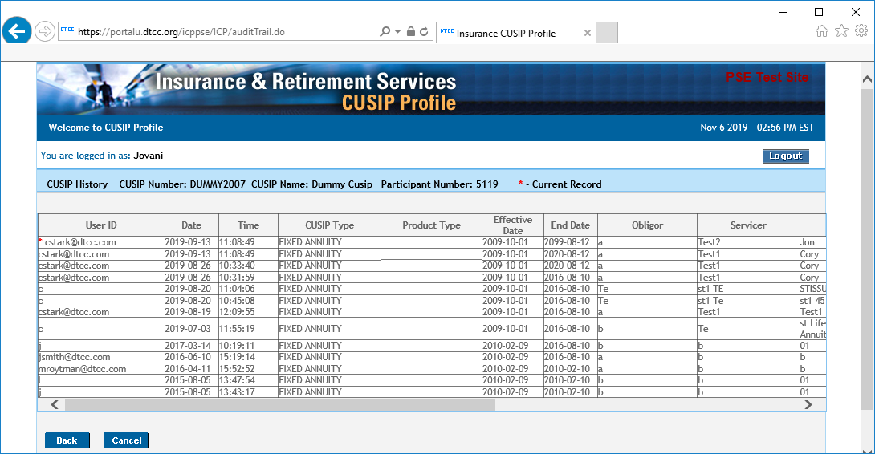

CUSIP History
The first row in the CUSIP history is the most recent update.
If the first row is empty, the CUSIP has been deleted.
The bottom row is the original CUSIP.

