Slide 1
ETF T0 Phases 1 & 2
Phase 1
Targeted Go-Live: May 28, 2024
Features:
  T0 SDS Cr/Rd Cycle
  Acceptance of Cash Collateral Amount
  Intraday Cr/Rd Instruction Detail Blotter
  Acceptance of Collateral Cash Adjustment and Sign Indicator (Reporting purposes ONLY)
Phase 2
Targeted Go-Live: June 2024
Features:
  Acceptance/Collection of the Collateral Cash Adjustment
  Facilitation of the EOD True-up through a new NSCC Money Settlement Code

Slide 2
ETF T0 Create/Redeem Cycle Timeline
12:15 PM
Intraday Cr/Rd Instruction Detail Blotter Cutoff
All T0 orders received before this cutoff will be included in the Intraday IDB anything received after will be a real time message from UTC or on 9 PM IDB
FILE: DATATRAK 11300
1:30 PM
T0 Cycle
&
CNS SDS Cycle close
(hard cutoff)
12:30 AM
T0 Cycle opens for the day
4:30 AM*
CNS SDS cycle opens
8:45 PM
Primary Cycle closes
11:30 PM
Secondary cycle closes
4:00 AM*
12:30 PM
2:00 PM
9:00 PM
4:00 AM*
UTC opens ETF streams T0 orders in near real-time
FILE: DATATRAK 11300
12:30 PM
Intraday Cr/Rd Instruction Detail Blotter distributed
(T0 ONLY)
FILE: AUTOROUTE 02261254
2:00 PM
Primary Cycle opens
9:00 PM
Primary Cycle Instruction Detail Blotter distributed
FILE: AUTOROUTE 02261254
&
Secondary Cycle Opens
12:30 AM
4:30 AM*
1:30 PM
8:45 PM
11:30 PM
Window to submit True-Up
T0 Collateral Cash Adjustment & Sign Indicator
Agents send updated 11300 file with Collateral Cash Adjustment and Sign Indicator.
FILE: DATATRAK 11300
* Time shown is an approximate time and is subject to change.
There is no changes to any of the Reject/Receipt reports that are agent only

Slide 3
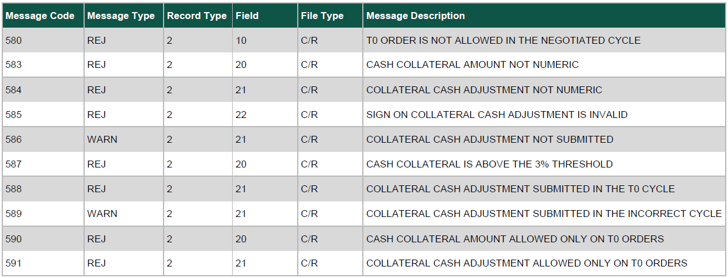
ETF T0 Message Codes

Slide 4
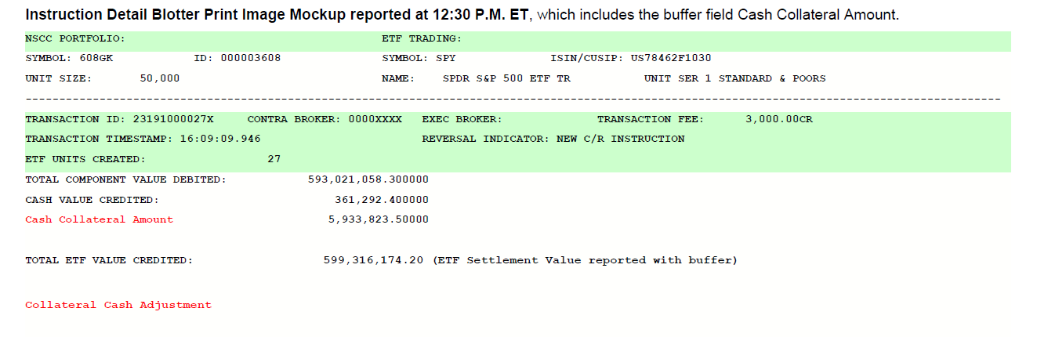
Intraday Instruction Detail Blotter Example

Slide 5
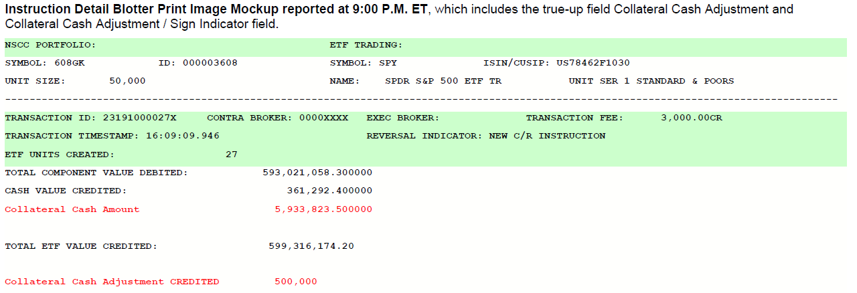
EOD Instruction Detail Blotter Example

Slide 6
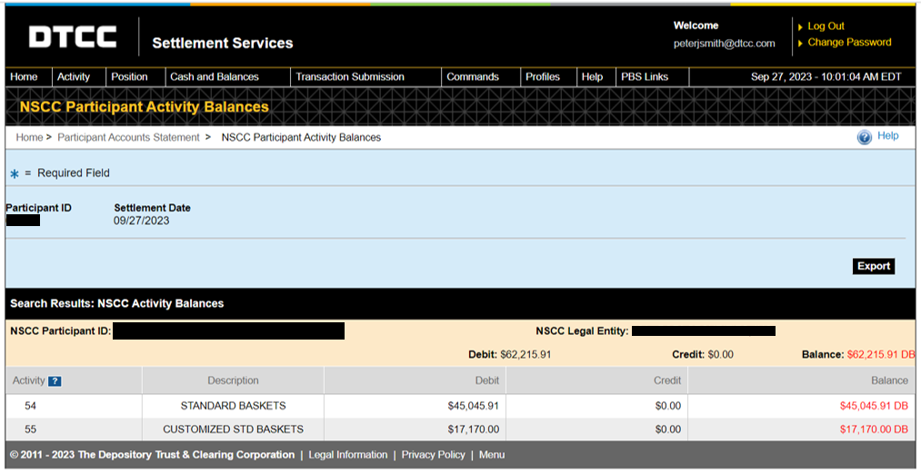
EOD Instruction Detail Blotter Example

